Slide 1
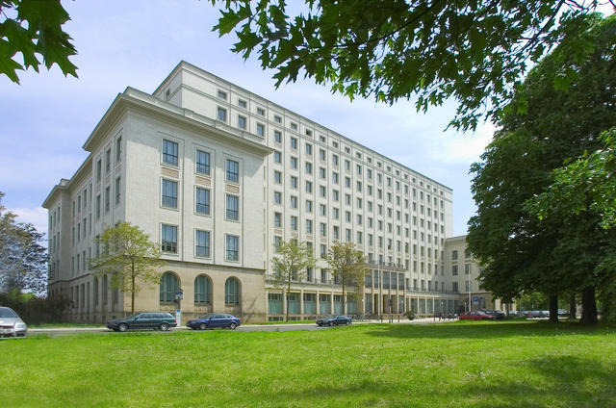
Opportunities and methods of using ClassPad
Dresden University of Applied Sciences

Slide 2
Opportunities and methods of using ClassPad
Something about myself: Paul Ernst Ludwig Paditz
Education:
Diploma mathematics, TU Dresden, Germany, 1974.
Doctor Natural Science (Dr.rer.nat.), TU, Dresden, Germany, 1977.
Postgrad., State University, St. Petersburg, Russia, 1984-1985.
Habilitation (Dr.rer.nat.habil.), HfV Dresden, Germany, 1989.
Working:
Assistant, department mathematics, TU Dresden, 1977-1979.
Head assistant, HfV Dresden, Institute of Mathematics, 1979-1991,
applied professor, HfV Dresden, 1992.
Professor, Faculty informatics/mathematics, Univ. of Applied Sciences, Dresden, since 1992.

Slide 3
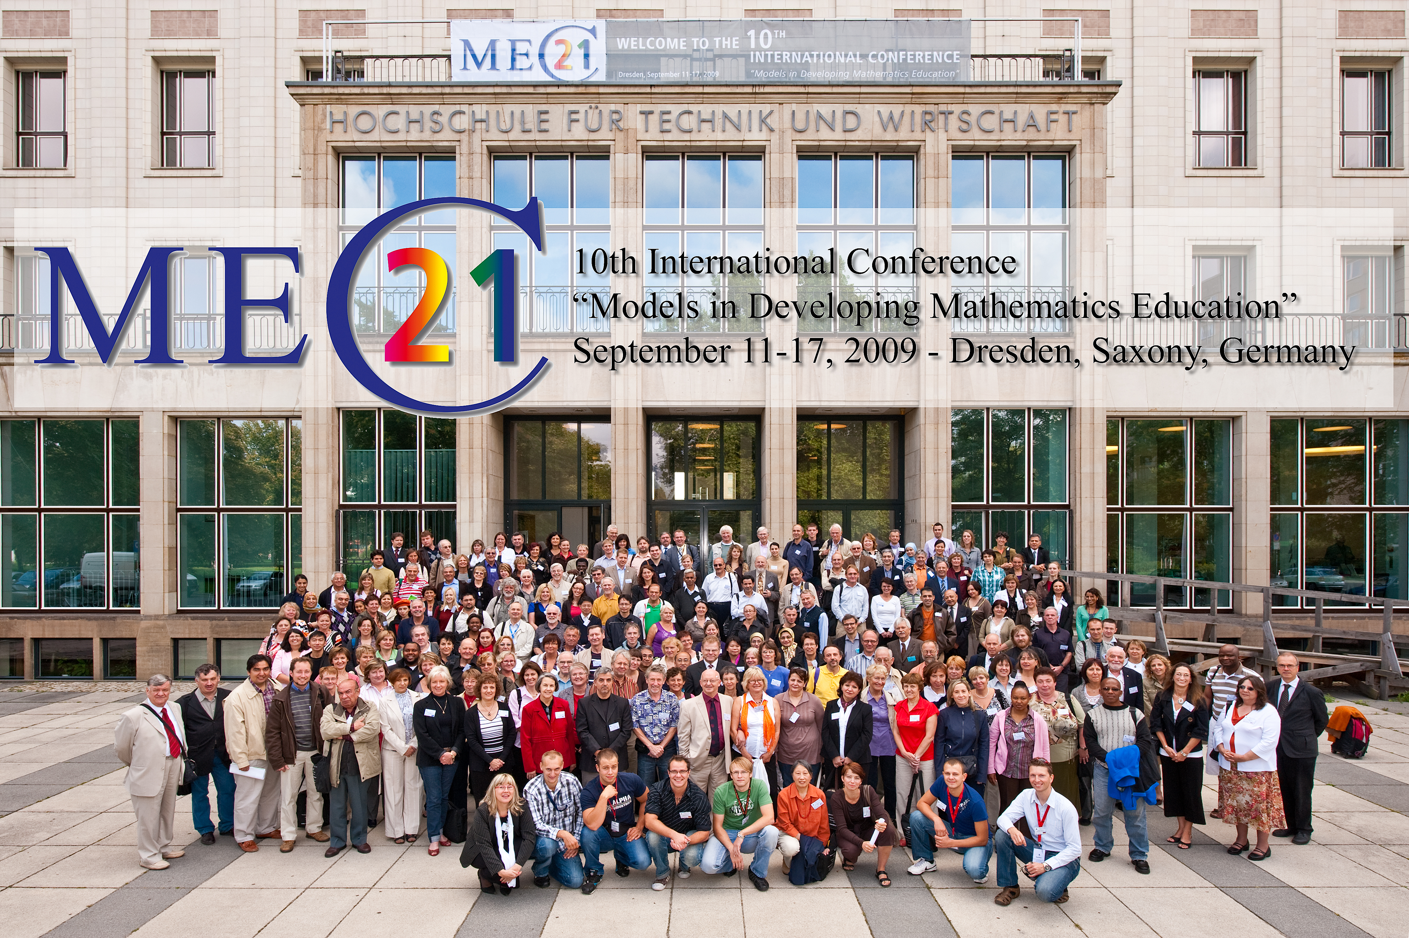
Opportunities and methods of using ClassPad

Slide 4
Opportunities and methods of using ClassPad
Using CAS in Math Education –
first experience in Germany with the newest ClassPad technology CP400
Preface:
Ministry of Education in Saxony/Germany introduced 2004:
Modern Math Education with CAS, DGS and TC
beginning in the 8th class upto 12th class,
using graphic calculators (GTR)
CAS – Computer Algebra Systems
DGS – Dynamic Geometry Software
TC – Spreadsheet (Table Calculation)

Slide 5
Opportunities and methods of using ClassPad
8th class:
- Knowledge of the use of CAS when forming more complex
terms and equations
- Investigating the influence of parameters in the function
equation to trace the graph with DGS, TC, GTR or CAS
- Finding equations for measurement series with the help of
linear regression with GTR, CAS or TC
- Solving linear systems of equations with more complex
coefficients with GTR or CAS (two equations with two
unknown variables)

Slide 6
Opportunities and methods of using ClassPad
9th class:
Functions and Powers
Mastered of determining zero quadratic functions, graphical solving quadratic equations and solving with GTR or CAS
10th class:
Obtaining the inverse function with CAS, graphical interpretation
Use of CAS to demonstrate the properties of functions Obtaining illustrative of the limit concept
Know of parametric representation and polar coordinates to describe curves with GTR and CAS

Slide 7
Opportunities and methods of using ClassPad
11/12th class:
Differential calculus
The use of CAS in particular, should promote discovery learning, and support for substantive tasks, the reflection on the facts and the interpretation of the result.
Integral Calculus
The use of CAS in particular, should promote discovery learning, and support for substantive tasks, the reflection on the facts and the interpretation of the result.

Slide 8
Opportunities and methods of using ClassPad
worksheets:
The use of worksheets in mathematics instruction has a
long tradition.
The use of a worksheet should guide the students to a
structured work.
Instead of an oral instruction, which requires a synchronous
work of all students, the worksheet individually and with their
own timing can be processed next.
☞ The sequence of the work orders in the worksheet helps to
recognize the logical structure of a problem;
the work procedures help to penetrate the question.

Slide 9
Opportunities and methods of using ClassPad
worksheets:
The disadvantage of a sheet of paper with work orders is seen, that the tools which can be used must be made available about. The students do not know always, how to carry out its solution steps in detail. Moreover, in a classic worksheet are missing the self check of the results, a feedback of the partial steps and also the visualization of the results.
The new developed eActivity in the ClassPad represents an extremely rich extension of the worksheet. The eActivity com-bines the written representation of the setting of tasks of a worksheet with the tool level of the ClassPad.
These tools are the individual menus or modules, which the ClassPad offers: Computer algebra system, dynamic geometry software, computer statistics, curve plotter, and much more.

Slide 10
Opportunities and methods of using ClassPad
eActivity:
Thus, all tasks can be worked on with the possibilities of the
computer.
At the same time, the documentation of the work can be
entered directly.
The found results can to be visualized immediately or the
results may be in a hidden file, can be viewed.
It is an interactive work of the students, between setting of
tasks and the results and control of the results themselves.

Slide 11
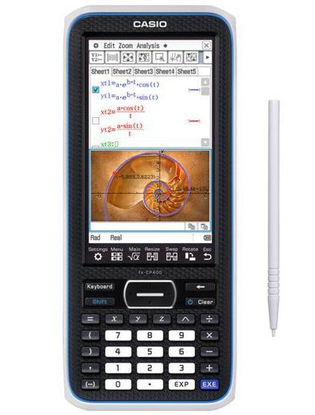
Opportunities and methods of using ClassPad
The tool – ClassPad 400:
Графический калькулятор
с сенсорным дисплеем
Fx-CP400 обладает рядом функций, помогающих школьникам лучше усваивать материал:
USB поддержка для быстрой и легкой передачи данных и сов-местимость с проектором CASIO для отображения информации на доске.
http://edu.casio.ru/fx-cp400/

Slide 12
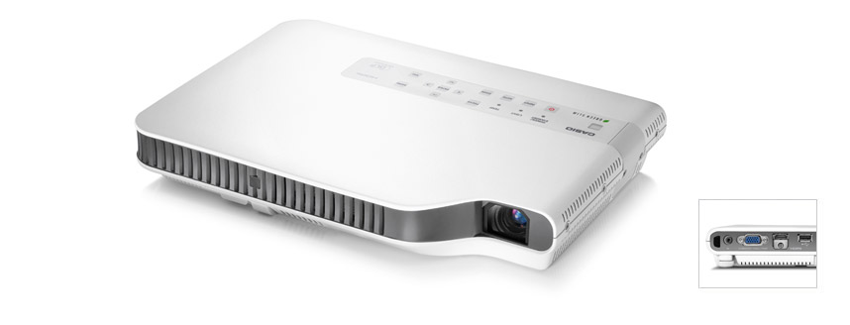
Opportunities and methods of using ClassPad
The tool – Beamer XJ-A146:
http://casio-projectors.ru/products/xja146/

Slide 13
Opportunities and methods of using ClassPad
eActivity –
an example
According to the instructions from the formula construct a rhombus:

Slide 14
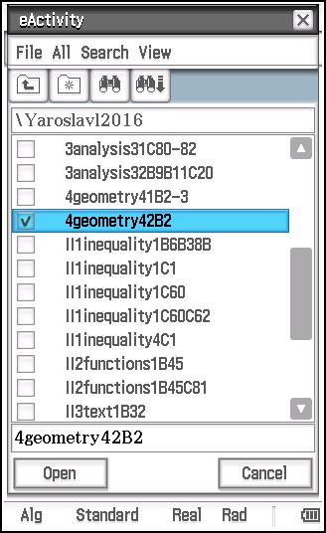
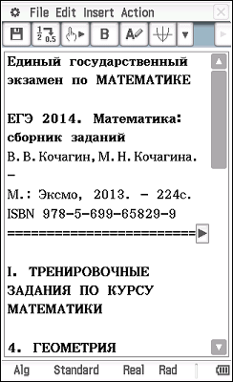
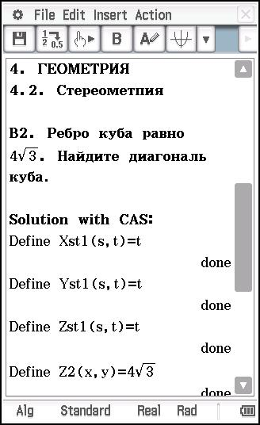
Opportunities and methods of using ClassPad
eActivity: 4. ГЕОМЕТРИЯ 4.2. Стереометпия
Ребро куба равно 4√(3). Найдите диагональ куба.

Slide 15
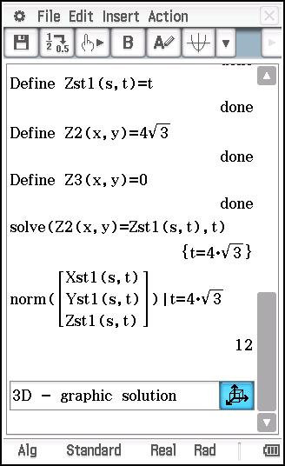
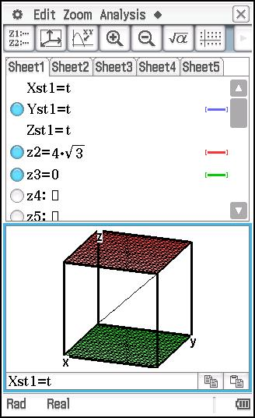
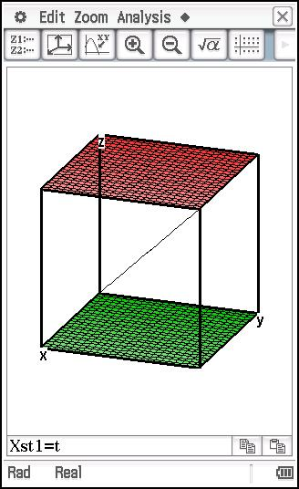
Opportunities and methods of using ClassPad
eActivity: 4. ГЕОМЕТРИЯ 4.2. Стереометпия
Ответ: диагональ куба равно 12.

Slide 16
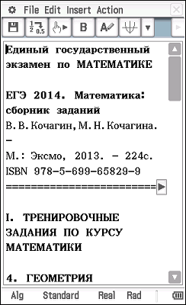
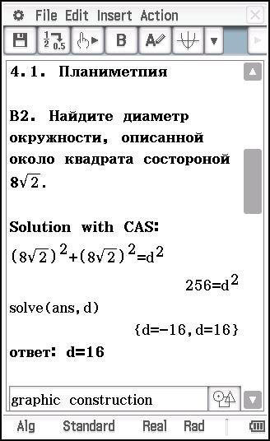
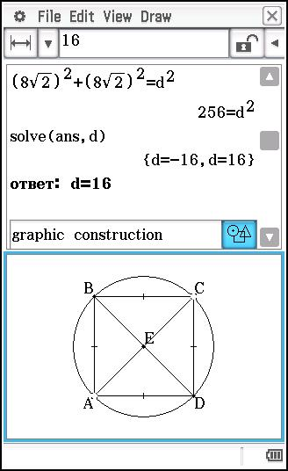
Opportunities and methods of using ClassPad
eActivity: 4. ГЕОМЕТРИЯ 4.1. Планиметпия
Найдите диаметр окружности, описанной около
квадрата состороной 8√(2).

Slide 17
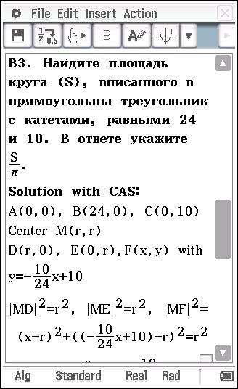
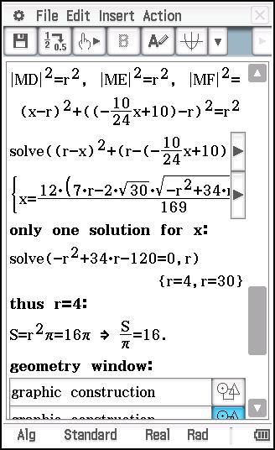
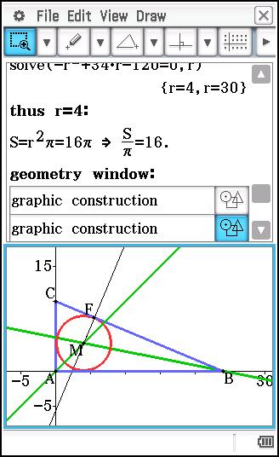
Opportunities and methods of using ClassPad
eActivity: 4. ГЕОМЕТРИЯ 4.1. Планиметпия
Найдите площадь круга (S), вписанного в прямо-
угольны треугольник с катетами, равными 24 и 10.
В ответе укажите S/π.

Slide 18
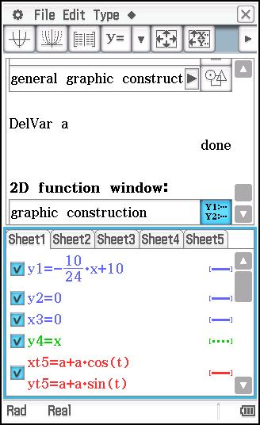
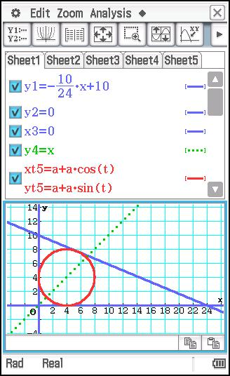
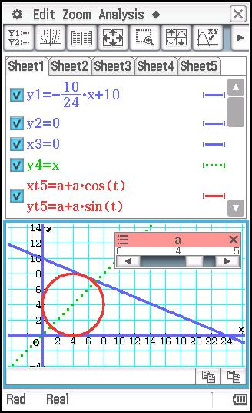
Opportunities and methods of using ClassPad
eActivity: 4. ГЕОМЕТРИЯ 4.1. Планиметпия
Найдите площадь круга (S), вписанного в прямо-
угольны треугольник с катетами, равными 24 и 10.
В ответе укажите S/π.

Slide 19
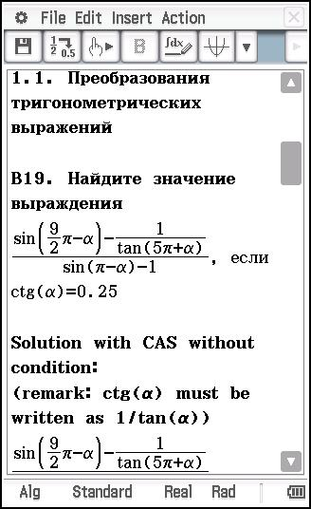
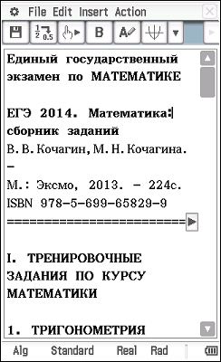
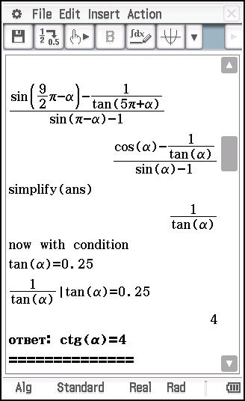
Opportunities and methods of using ClassPad
eActivity: 1. ТРИГОНОМЕТРИЯ
1.1. Преобразования тригонометрических
выражений

Slide 20
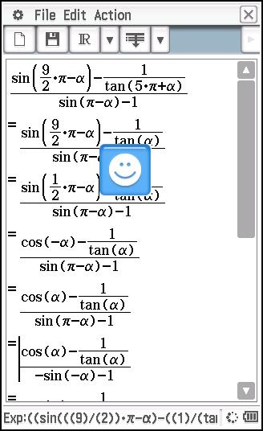
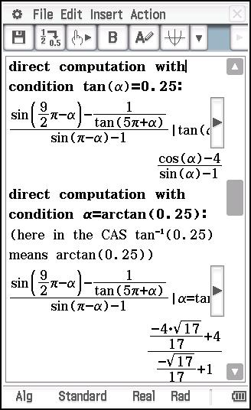
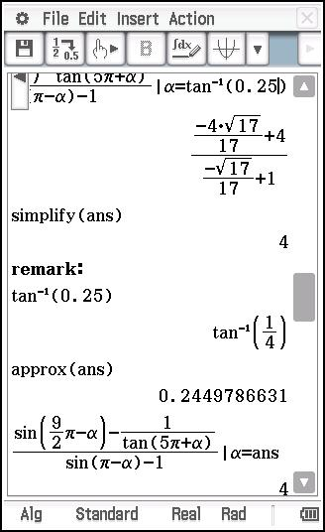
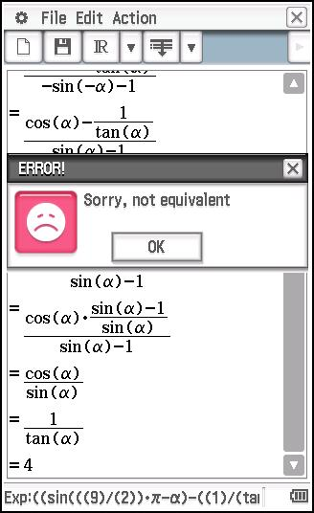
Opportunities and methods of using ClassPad
eActivity: 1. ТРИГОНОМЕТРИЯ
1.1. Преобразования тригонометрических
выражений

Slide 21
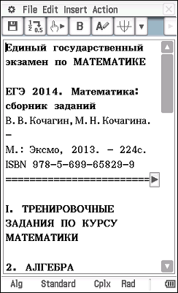
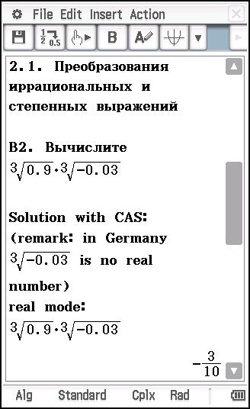
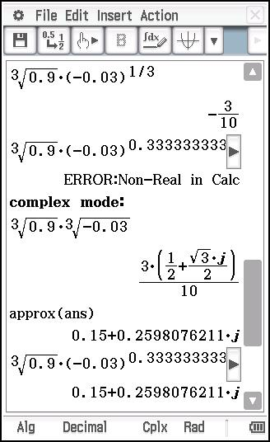
Opportunities and methods of using ClassPad
eActivity: 2. АЛГЕБРА
2.1. Преобразования иррациональных и
степенных выражений

Slide 22
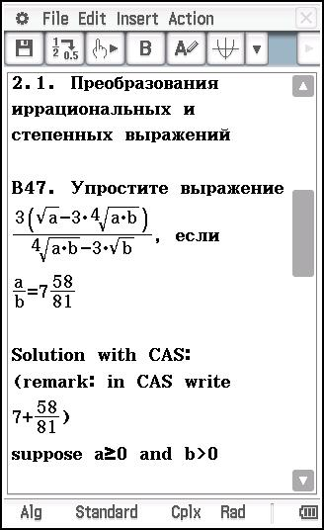
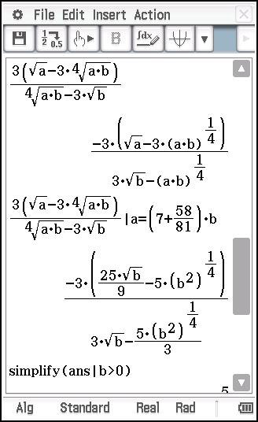
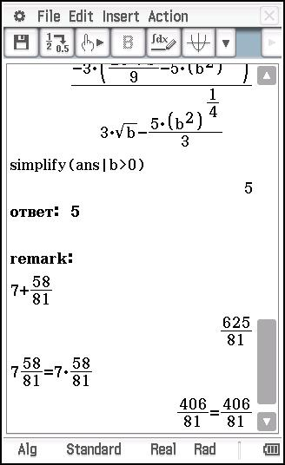
Opportunities and methods of using ClassPad
eActivity: 2. АЛГЕБРА
2.1. Преобразования иррациональных и
степенных выражений

Slide 23
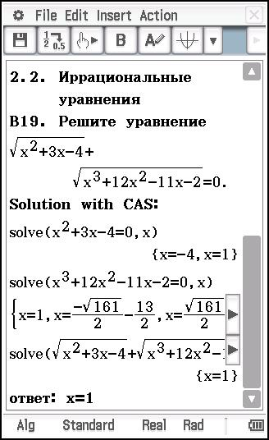
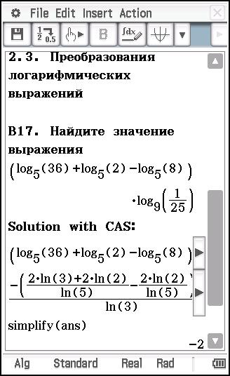
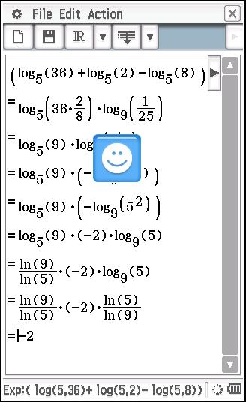
Opportunities and methods of using ClassPad
eActivity: 2. АЛГЕБРА
2.2. Иррациональные уравнения
2.3. Преобразования логарифмических выражений

Slide 24
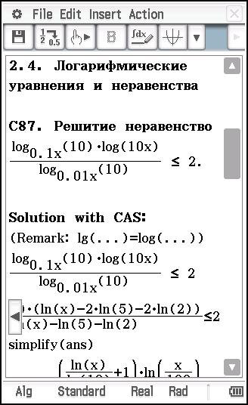
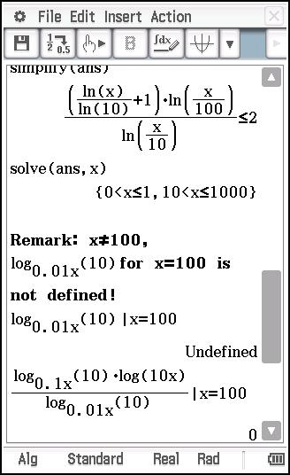
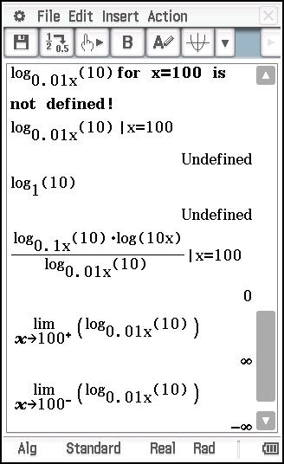
Opportunities and methods of using ClassPad
eActivity: 2. АЛГЕБРА
2.4. Логарифмические уравнения и неравенства

Slide 25
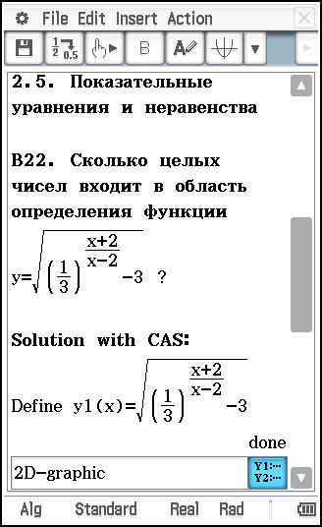
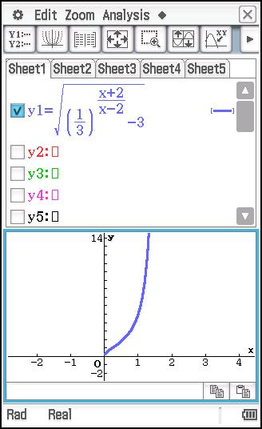
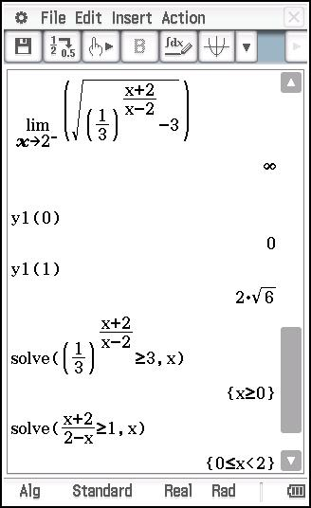
Opportunities and methods of using ClassPad
eActivity: 2. АЛГЕБРА
2.5. Показательные уравнения и неравенства
ответ: 2 (x=0, x=1)

Slide 26
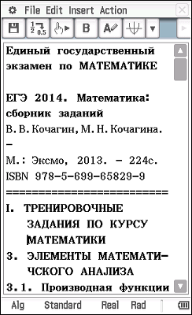
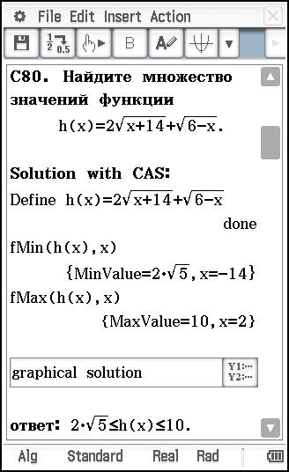
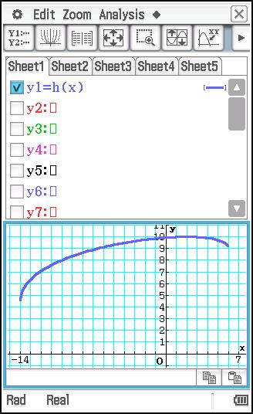
Opportunities and methods of using ClassPad
eActivity: 3. ЭЛЕМЕНТЫ МАТЕМАТИЧСКОГО АНАЛИЗА
3.1. Производная функции
ответ: 2√(5)≤h(x)≤10

Slide 27
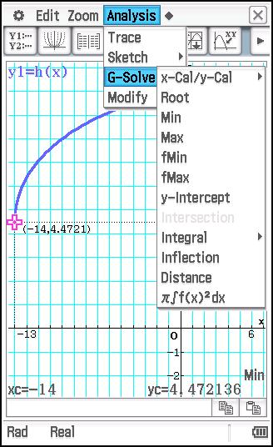
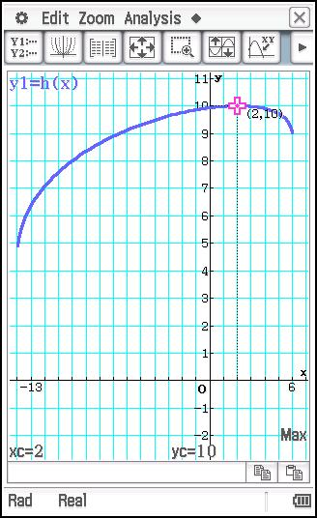
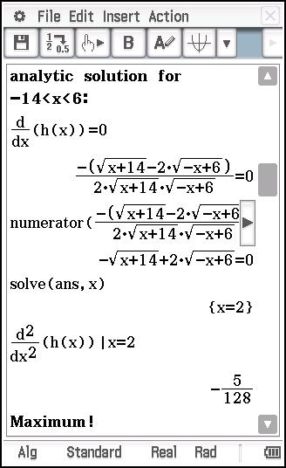
Opportunities and methods of using ClassPad
eActivity: 3. ЭЛЕМЕНТЫ МАТЕМАТИЧСКОГО АНАЛИЗА
3.1. Производная функции
ответ: 4.472136≤h(x)≤10

Slide 28
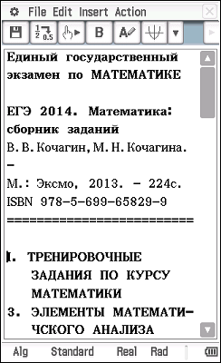
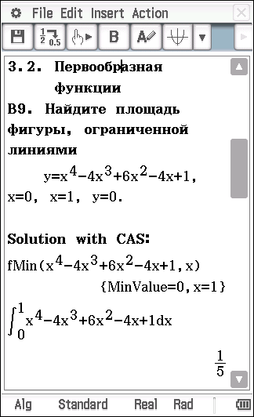
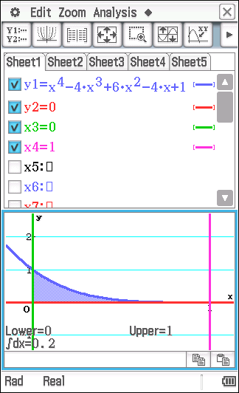
Opportunities and methods of using ClassPad
eActivity: 3. ЭЛЕМЕНТЫ МАТЕМАТИЧСКОГО АНАЛИЗА
3.2. Первообразная функции
ответ: 0.2

Slide 29
Opportunities and methods of using ClassPad
eActivity: 3. ЭЛЕМЕНТЫ МАТЕМАТИЧСКОГО АНАЛИЗА
3.2. Первообразная функции
ответ: 16

Slide 30
Opportunities and methods of using ClassPad
eActivity: 3. ЭЛЕМЕНТЫ МАТЕМАТИЧСКОГО АНАЛИЗА
3.2. Первообразная функции
ответ: 2+2/3

Slide 31
Opportunities and methods of using ClassPad
eActivity: II. ТРЕНИРОВОЧНЫЕ ЗАДАНИЯ ИЗ
РАЗДЕЛОВ МАТЕМАТИКИ
1. РАЦИОНАЛНЫЕ НЕРАВЕНСТВА
ответ: -1/2

Slide 32
Opportunities and methods of using ClassPad
eActivity: II. ТРЕНИРОВОЧНЫЕ ЗАДАНИЯ ИЗ
РАЗДЕЛОВ МАТЕМАТИКИ
1. РАЦИОНАЛНЫЕ НЕРАВЕНСТВА
ответ: 1

Slide 33
Opportunities and methods of using ClassPad
eActivity: II. ТРЕНИРОВОЧНЫЕ ЗАДАНИЯ ИЗ
РАЗДЕЛОВ МАТЕМАТИКИ
1. РАЦИОНАЛНЫЕ НЕРАВЕНСТВА
ответ: -6

Slide 34
Opportunities and methods of using ClassPad
eActivity: II. ТРЕНИРОВОЧНЫЕ ЗАДАНИЯ ИЗ
РАЗДЕЛОВ МАТЕМАТИКИ
1. РАЦИОНАЛНЫЕ НЕРАВЕНСТВА
ответ: x=-4, x=5, -3≤x<3/2

Slide 35
Opportunities and methods of using ClassPad
eActivity: II. ТРЕНИРОВОЧНЫЕ ЗАДАНИЯ ИЗ
РАЗДЕЛОВ МАТЕМАТИКИ
1. РАЦИОНАЛНЫЕ НЕРАВЕНСТВА
ответ: -6≤x≤-1, 1≤x<2

Slide 36
Opportunities and methods of using ClassPad
eActivity: II. ТРЕНИРОВОЧНЫЕ ЗАДАНИЯ ИЗ
РАЗДЕЛОВ МАТЕМАТИКИ
2. ИССЛЕДОВАНИЕ ФУНКЦИЙ ЭЛЕМЕНТАРНЫМИ МЕТОДАМИ
ответ: y=-4 for x=0

Slide 37
Opportunities and methods of using ClassPad
eActivity: II. ТРЕНИРОВОЧНЫЕ ЗАДАНИЯ ИЗ
РАЗДЕЛОВ МАТЕМАТИКИ
2. ИССЛЕДОВАНИЕ ФУНКЦИЙ ЭЛЕМЕНТАРНЫМИ МЕТОДАМИ
ответ: - ∞ < x ≤ 1

Slide 38
Opportunities and methods of using ClassPad
eActivity: II. ТРЕНИРОВОЧНЫЕ ЗАДАНИЯ ИЗ
РАЗДЕЛОВ МАТЕМАТИКИ
2. ИССЛЕДОВАНИЕ ФУНКЦИЙ ЭЛЕМЕНТАРНЫМИ МЕТОДАМИ
ответ: 1/64 ≤ x ≤ 1/8

Slide 39
Opportunities and methods of using ClassPad
eActivity: II. ТРЕНИРОВОЧНЫЕ ЗАДАНИЯ ИЗ
РАЗДЕЛОВ МАТЕМАТИКИ
2. ИССЛЕДОВАНИЕ ФУНКЦИЙ ЭЛЕМЕНТАРНЫМИ МЕТОДАМИ
ответ: 1 ≤ a ≤ 3

Slide 40
Opportunities and methods of using ClassPad
eActivity: II. ТРЕНИРОВОЧНЫЕ ЗАДАНИЯ ИЗ
РАЗДЕЛОВ МАТЕМАТИКИ
2. ИССЛЕДОВАНИЕ ФУНКЦИЙ ЭЛЕМЕНТАРНЫМИ МЕТОДАМИ
ответ: a = -3

Slide 41
Opportunities and methods of using ClassPad
eActivity: II. ТРЕНИРОВОЧНЫЕ ЗАДАНИЯ ИЗ
РАЗДЕЛОВ МАТЕМАТИКИ
3. ТЕКСТОВЫЕ ЗАДАЧИ
ответ: 600

Slide 42
Opportunities and methods of using ClassPad
eActivity: II. ТРЕНИРОВОЧНЫЕ ЗАДАНИЯ ИЗ
РАЗДЕЛОВ МАТЕМАТИКИ
4. УРАВНЕНИЯ И НЕРАВЕНСТВА С МОДУЛЕМ
ответ: 270°

Slide 43
Opportunities and methods of using ClassPad
eActivity: II. ТРЕНИРОВОЧНЫЕ ЗАДАНИЯ ИЗ
РАЗДЕЛОВ МАТЕМАТИКИ
4. УРАВНЕНИЯ И НЕРАВЕНСТВА С МОДУЛЕМ
ответ: -0.25

Slide 44
Opportunities and methods of using ClassPad
eActivity: II. ТРЕНИРОВОЧНЫЕ ЗАДАНИЯ ИЗ
РАЗДЕЛОВ МАТЕМАТИКИ
4. УРАВНЕНИЯ И НЕРАВЕНСТВА С МОДУЛЕМ
ответ: x>8

Slide 45
Opportunities and methods of using ClassPad
eActivity: II. ТРЕНИРОВОЧНЫЕ ЗАДАНИЯ ИЗ
РАЗДЕЛОВ МАТЕМАТИКИ
4. УРАВНЕНИЯ И НЕРАВЕНСТВА С МОДУЛЕМ
ответ: x>5

Slide 46
Opportunities and methods of using ClassPad
eActivity: II. ТРЕНИРОВОЧНЫЕ ЗАДАНИЯ ИЗ
РАЗДЕЛОВ МАТЕМАТИКИ
4. УРАВНЕНИЯ И НЕРАВЕНСТВА С МОДУЛЕМ
ответ: x ∈ [-√(17), -4) ⋃ (4, √(17)] ⋃ [5,∞)

Slide 47
Opportunities and methods of using ClassPad
eActivity: II. ТРЕНИРОВОЧНЫЕ ЗАДАНИЯ ИЗ
РАЗДЕЛОВ МАТЕМАТИКИ
4. УРАВНЕНИЯ И НЕРАВЕНСТВА С МОДУЛЕМ

Slide 48
Opportunities and methods of using ClassPad
eActivity: II. ТРЕНИРОВОЧНЫЕ ЗАДАНИЯ ИЗ
РАЗДЕЛОВ МАТЕМАТИКИ
4. УРАВНЕНИЯ И НЕРАВЕНСТВА С МОДУЛЕМ
ответ: x ∈ [-√(17), -4) ⋃ (4, √(17)] ⋃ [5,∞)

Slide 49
Opportunities and methods of using ClassPad
eActivity: II. ТРЕНИРОВОЧНЫЕ ЗАДАНИЯ ИЗ
РАЗДЕЛОВ МАТЕМАТИКИ
4. УРАВНЕНИЯ И НЕРАВЕНСТВА С МОДУЛЕМ
ответ: x ∈ [-√(17), -4) ⋃ (4, √(17)] ⋃ [5,∞)

Slide 50
Opportunities and methods of using ClassPad
eActivity: II. ТРЕНИРОВОЧНЫЕ ЗАДАНИЯ ИЗ
РАЗДЕЛОВ МАТЕМАТИКИ
5. ЭЛЕМЕНТЫ КОМБИНАТОРИКИ,ТЕОРИИ ВЕРОЯТНОСТЕЙ И
СТАТИСТИКИ
ответ:

Slide 51
Opportunities and methods of using ClassPad
eActivity: II. ТРЕНИРОВОЧНЫЕ ЗАДАНИЯ ИЗ
РАЗДЕЛОВ МАТЕМАТИКИ
5. ЭЛЕМЕНТЫ КОМБИНАТОРИКИ,ТЕОРИИ ВЕРОЯТНОСТЕЙ И
СТАТИСТИКИ
ответ: а)9 б)7 в)5

Slide 52
Opportunities and methods of using ClassPad
eActivity: II. ТРЕНИРОВОЧНЫЕ ЗАДАНИЯ ИЗ
РАЗДЕЛОВ МАТЕМАТИКИ
5. ЭЛЕМЕНТЫ КОМБИНАТОРИКИ,ТЕОРИИ ВЕРОЯТНОСТЕЙ И
СТАТИСТИКИ
ответ: а)0.928 б)0.168

Slide 53
Opportunities and methods of using ClassPad
eActivity: II. ТРЕНИРОВОЧНЫЕ ЗАДАНИЯ ИЗ
РАЗДЕЛОВ МАТЕМАТИКИ
5. ЭЛЕМЕНТЫ КОМБИНАТОРИКИ,ТЕОРИИ ВЕРОЯТНОСТЕЙ И
СТАТИСТИКИ – Venn-diagram with 4 sets A,B,C,D⊂Ω
ответ:

Slide 54
Opportunities and methods of using ClassPad
eActivity: II. ТРЕНИРОВОЧНЫЕ ЗАДАНИЯ ИЗ
РАЗДЕЛОВ МАТЕМАТИКИ
5. ЭЛЕМЕНТЫ КОМБИНАТОРИКИ,ТЕОРИИ ВЕРОЯТНОСТЕЙ И
СТАТИСТИКИ – Venn-diagram with 4 sets A,B,C,D⊂Ω
ответ:

Slide 55
Opportunities and methods of using ClassPad
eActivity: II. ТРЕНИРОВОЧНЫЕ ЗАДАНИЯ ИЗ
РАЗДЕЛОВ МАТЕМАТИКИ
5. ЭЛЕМЕНТЫ КОМБИНАТОРИКИ,ТЕОРИИ ВЕРОЯТНОСТЕЙ И
СТАТИСТИКИ – Compute Ω\(A⋃B⋃C⋃D) with 4 sets A,B,C,D⊂Ω
ответ:

Slide 56
Opportunities and methods of using ClassPad
eActivity: II. ТРЕНИРОВОЧНЫЕ ЗАДАНИЯ ИЗ
РАЗДЕЛОВ МАТЕМАТИКИ
5. ЭЛЕМЕНТЫ КОМБИНАТОРИКИ,ТЕОРИИ ВЕРОЯТНОСТЕЙ И
СТАТИСТИКИ
ответ:

Slide 57
Opportunities and methods of using ClassPad
eActivity: II. ТРЕНИРОВОЧНЫЕ ЗАДАНИЯ ИЗ
РАЗДЕЛОВ МАТЕМАТИКИ
5. ЭЛЕМЕНТЫ КОМБИНАТОРИКИ,ТЕОРИИ ВЕРОЯТНОСТЕЙ И
СТАТИСТИКИ (Boxplot)
ответ:

Slide 58
Opportunities and methods of using ClassPad
eActivity: II. ТРЕНИРОВОЧНЫЕ ЗАДАНИЯ ИЗ
РАЗДЕЛОВ МАТЕМАТИКИ
5. ЭЛЕМЕНТЫ КОМБИНАТОРИКИ,ТЕОРИИ ВЕРОЯТНОСТЕЙ И
СТАТИСТИКИ
ответ: -2°

Slide 59
Opportunities and methods of using ClassPad
eActivity: II. ТРЕНИРОВОЧНЫЕ ЗАДАНИЯ ИЗ
РАЗДЕЛОВ МАТЕМАТИКИ
5. ЭЛЕМЕНТЫ КОМБИНАТОРИКИ,ТЕОРИИ ВЕРОЯТНОСТЕЙ И
СТАТИСТИКИ
ответ: -2°

Slide 60
Opportunities and methods of using ClassPad
eActivity: II. ТРЕНИРОВОЧНЫЕ ЗАДАНИЯ ИЗ
РАЗДЕЛОВ МАТЕМАТИКИ
5. ЭЛЕМЕНТЫ КОМБИНАТОРИКИ,ТЕОРИИ ВЕРОЯТНОСТЕЙ И
СТАТИСТИКИ
ответ: -2°

Slide 61
Opportunities and methods of using ClassPad
eActivity: E.I.Smirnov – lecture in Dresden 20.07.2016
Science Learning with Information Technologies
as a Tool for "Scientific Thinking"
Innovative approaches in teaching
and learning mathematics
Problem of Visualization
Intersection of two cylinders
under a direct angle
ответ:

Slide 62
Opportunities and methods of using ClassPad
eActivity: E.I.Smirnov – lecture in Dresden 20.07.2016
Science Learning with Information Technologies
as a Tool for "Scientific Thinking"
Innovative approaches in teaching
and learning mathematics
Problem of Visualization
Intersection of two cylinders
under a direct angle
ответ:

Slide 63
Opportunities and methods of using ClassPad
eActivity: E.I.Smirnov – lecture in Dresden 20.07.2016
Science Learning with Information Technologies
as a Tool for "Scientific Thinking"
Innovative approaches in teaching
and learning mathematics
Problem of Visualization
Intersection of two cylinders
under a direct angle
ответ:

Slide 64
Opportunities and methods of using ClassPad
eActivity: E.I.Smirnov – lecture in Dresden 20.07.2016
Science Learning with Information Technologies
as a Tool for "Scientific Thinking"
ответ:

Slide 65
Opportunities and methods of using ClassPad
eActivity: E.I.Smirnov – lecture in Dresden 20.07.2016
Science Learning with Information Technologies
as a Tool for "Scientific Thinking"
ответ:

Slide 66
Opportunities and methods of using ClassPad
eActivity: E.I.Smirnov – lecture in Dresden 20.07.2016
Science Learning with Information Technologies
as a Tool for "Scientific Thinking"
ответ:

Slide 67
Opportunities and methods of using ClassPad
eActivity: E.I.Smirnov – lecture in Dresden 20.07.2016
Science Learning with Information Technologies
as a Tool for "Scientific Thinking"
ответ:

Slide 68
Opportunities and methods of using ClassPad
eActivity: E.I.Smirnov – lecture in Dresden 20.07.2016
Science Learning with Information Technologies
as a Tool for "Scientific Thinking"
ответ:

Slide 69
Opportunities and methods of using ClassPad
eActivity: E.I.Smirnov – lecture in Dresden 20.07.2016
Science Learning with Information Technologies
as a Tool for "Scientific Thinking"
Innovative approaches in teaching
and learning mathematics
Problem of Visualization
Intersection of a cylinder and a cone

Slide 70
Opportunities and methods of using ClassPad
eActivity: E.I.Smirnov – lecture in Dresden 20.07.2016
Science Learning with Information Technologies
as a Tool for "Scientific Thinking"

Slide 71
Opportunities and methods of using ClassPad
eActivity: E.I.Smirnov – lecture in Dresden 20.07.2016
Science Learning with Information Technologies
as a Tool for "Scientific Thinking"

Slide 72
Opportunities and methods of using ClassPad
eActivity: E.I.Smirnov – lecture in Dresden 20.07.2016
Science Learning with Information Technologies
as a Tool for "Scientific Thinking"
Innovative approaches in teaching
and learning mathematics
Problem of subject's Essence
To find the limit of a sequence Mn

Slide 73
Opportunities and methods of using ClassPad
eActivity: E.I.Smirnov – lecture in Dresden 20.07.2016
Science Learning with Information Technologies
as a Tool for "Scientific Thinking"

Slide 74
Opportunities and methods of using ClassPad
eActivity: E.I.Smirnov – lecture in Dresden 20.07.2016
Science Learning with Information Technologies
as a Tool for "Scientific Thinking"

Slide 75
Opportunities and methods of using ClassPad
eActivity: E.I.Smirnov – lecture in Dresden 20.07.2016
Science Learning with Information Technologies
as a Tool for "Scientific Thinking"

Slide 76
Opportunities and methods of using ClassPad
eActivity: E.I.Smirnov – lecture in Dresden 20.07.2016
Science Learning with Information Technologies
as a Tool for "Scientific Thinking"

Slide 77
Opportunities and methods of using ClassPad
Большое спасибо за ваше внимание!

