Slide 1
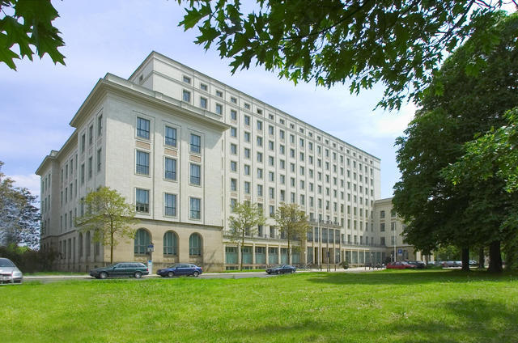
Math Education Today and Tomorrow
Dresden University of Applied Sciences

Slide 2
Math Education Today and Tomorrow
Using CAS in Math Education –
first experience in Germany with the newest ClassPad technology CP400
Preface:
Ministry of Education in Saxony/Germany introduced 2004:
Modern Math Education with CAS, DGS and TK
beginning in the 8th class upto 12th class,
using graphic calculators (GTR)
CAS – Computer Algebra Systems
DGS – Dynamic Geometry Software
TK – Spreadsheet (Table Calculation)

Slide 3
Math Education Today and Tomorrow
8th class:
- Knowledge of the use of CAS when forming more complex
terms and equations
- Investigating the influence of parameters in the function
equation to trace the graph with DGS, TK, GTR or CAS
- Finding equations for measurement series with the help of
linear regression with GTR, CAS or TK
- Solving linear systems of equations with more complex
coefficients with GTR or CAS (two equations with two
unknown variables)

Slide 4
Math Education Today and Tomorrow
9th class:
Functions and Powers
Mastered of determining zero quadratic functions, graphical solving quadratic equations and solving with GTR or CAS
10th class:
Obtaining the inverse function with CAS, graphical interpretation
Use of CAS to demonstrate the properties of functions Obtaining illustrative of the limit concept
Know of parametric representation and polar coordinates to describe curves with GTR and CAS

Slide 5
Math Education Today and Tomorrow
11/12th class:
Differential calculus
The use of CAS in particular, should promote discovery learning, and support for substantive tasks, the reflection on the facts and the interpretation of the result.
Integral Calculus
The use of CAS in particular, should promote discovery learning, and support for substantive tasks, the reflection on the facts and the interpretation of the result.

Slide 6
Math Education Today and Tomorrow
worksheets:
The use of worksheets in mathematics instruction has a
long tradition.
The use of a worksheet should guide the students to a
structured work.
Instead of an oral instruction, which requires a synchronous
work of all students, the worksheet individually and with their
own timing can be processed next.
☞ The sequence of the work orders in the worksheet helps to
recognize the logical structure of a problem;
the work procedures help to penetrate the question.

Slide 7
Math Education Today and Tomorrow
worksheets:
The disadvantage of a sheet of paper with work orders is seen, that the tools which can be used must be made available about. The students do not know always, how to carry out its solution steps in detail. Moreover, in a classic worksheet are missing the self check of the results, a feedback of the partial steps and also the visualization of the results.
The new developed eActivity in the ClassPad represents an extremely rich extension of the worksheet. The eActivity com-bines the written representation of the setting of tasks of a worksheet with the tool level of the ClassPad.
These tools are the individual menus or modules, which the ClassPad offers: Computer algebra system, dynamic geometry software, computer statistics, curve plotter, and much more.

Slide 8
Math Education Today and Tomorrow
eActivity:
Thus, all tasks can be worked on with the possibilities of the
computer.
At the same time, the documentation of the work can be
entered directly.
The found results can to be visualized immediately or the
results may be in a hidden file, can be viewed.
It is an interactive work of the students, between setting of
tasks and the results and control of the results themselves.

Slide 9
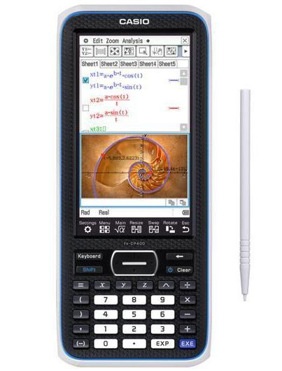
Math Education Today and Tomorrow
The tool – ClassPad 400:
Графический калькулятор
с сенсорным дисплеем
Fx-CP400 обладает рядом функций, помогающих школьникам лучше усваивать материал:
USB поддержка для быстрой и легкой передачи данных и сов-местимость с проектором CASIO для отображения информации на доске.
http://edu.casio.ru/fx-cp400/

Slide 10
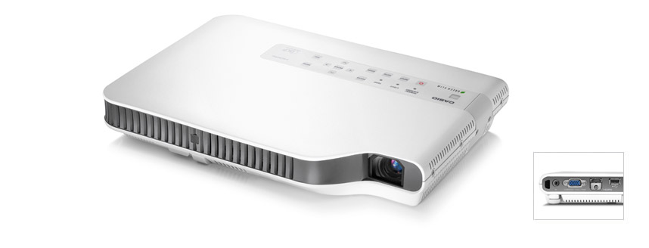
Math Education Today and Tomorrow
The tool – Beamer XJ-A146:
http://casio-projectors.ru/products/xja146/

Slide 11
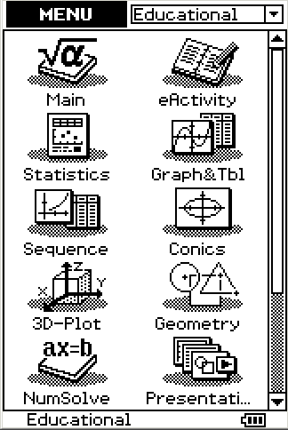
Math Education Today and Tomorrow
eActivity –
an example
According to the instructions from the formula construct a rhombus:

Slide 12
Math Education Today and Tomorrow
Большое спасибо за ваше внимание!

