Slide 1
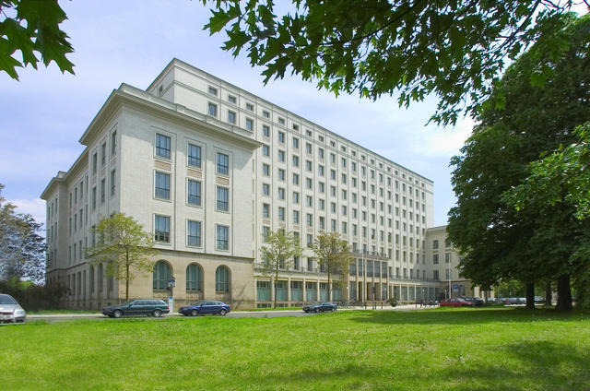
COMBINING BRUTE FORCE AND IT TO SOLVE A CLASSICAL SHOPPING PROBLEM
Dresden University of Applied Sciences
Faculty of Informatics and Mathematics

Slide 2
COMBINING BRUTE FORCE AND IT TO SOLVE A CLASSICAL SHOPPING PROBLEM
Two classic word problems with a similar background are mathematically modeled and a solution is provided.
The first problem, the puzzle of the "Dutch-men‘s Wives", can be found in a women's magazine (The Ladies Diary) as early as 1739 (May (1739)).
A similar problem (“Find Ada‘s Surname”, Workman (1906)) was formulated at the beginning of the last century.

Slide 3
COMBINING BRUTE FORCE AND IT TO SOLVE A CLASSICAL SHOPPING PROBLEM
The mathematical model leads to a Diophan-tine quadratic equation, which can be solved using the third binomial formula and a prime factor analysis.
First, a "stupid trial and error method" (brute force) is used to search for a solution.
The model is calculated exactly with a pocket calculator.
The CASIO-calculator/emulator ClassPad II will be used.

Slide 4
COMBINING BRUTE FORCE AND IT TO SOLVE A CLASSICAL SHOPPING PROBLEM
We want to sensitize the pupils to MINT (Mathematics, computer science (Informatics), Natural sciences and Technology) and to link interest with personal experiences.
We show the pupils that MINT is much more than the cliché of mathematics and computer programming.
For this purpose, the inhibition threshold for dealing with MINT should be lowered in the school project on the basis of playful, project-oriented didactics and at the same time interest in the topic should be encouraged.

Slide 5
COMBINING BRUTE FORCE AND IT TO SOLVE A CLASSICAL SHOPPING PROBLEM
Various projects are available.
“In conclusions, we point to the fact that there are several ways to demonstrate interrelations between traditional Maths and IT.”
Reference:
Hvorecký, Korenova, Barot (2022),
„Combining Brute Force and IT to Solve Difficult Problems“

Slide 6
COMBINING BRUTE FORCE AND IT TO SOLVE A CLASSICAL SHOPPING PROBLEM
The first word problem:
the puzzle of the “Dutchmen's Wives”
“There came three Dutchmen of my acquaintance to
see me, being lately married.
The men’s names were Hendrick, Claas, and Cornelius;
the women’s, Geertruii, Catriin, and Anna.
But I forgot the name of each man’s wife.
They told me they had been at market to buy hogs.
Each person bought as many hogs as they gave shillings for each hog.”

Slide 7
COMBINING BRUTE FORCE AND IT TO SOLVE A CLASSICAL SHOPPING PROBLEM
The first word problem:
the puzzle of the “Dutchmen's Wives”
“Hendrick bought 23 hogs more than Catriin,
and Claas bought 11 more than Geertruii;
likewise, each man laid out 3 guineas more
than his wife.
I desire to know the name of each man’s wife.”
References:
May (1739), Dudeney (1917), Hemme (2019).
Note: the guinea was a British gold coin in circulation from
1663 to 1816, one guinea = 21 shillings.

Slide 8
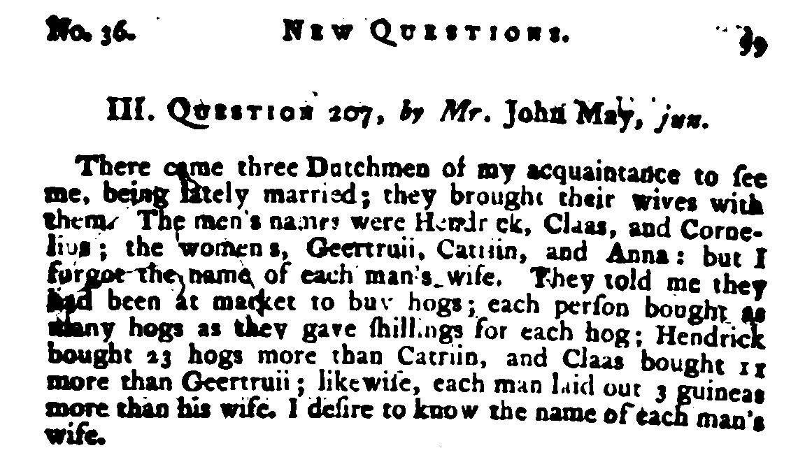
COMBINING BRUTE FORCE AND IT TO SOLVE A CLASSICAL SHOPPING PROBLEM

Slide 9
COMBINING BRUTE FORCE AND IT TO SOLVE A CLASSICAL SHOPPING PROBLEM

Slide 10
COMBINING BRUTE FORCE AND IT TO SOLVE A CLASSICAL SHOPPING PROBLEM
It is about a mathematical problem from 1739 that was published in a women's magazine and is still very popular today and is about married couples and later about mothers with their daughters going shopping.
You find the solution by "trying it out" or, as in the past, by clever thinking, since there was no computing technology or school calculator at that time.
Today "trying out" is easier, at least with a school calculator (here ClassPad II), if you don't have a clever idea for a solution yet.

Slide 11
COMBINING BRUTE FORCE AND IT TO SOLVE A CLASSICAL SHOPPING PROBLEM
Dudeney, H.E. (London, 1917). Amusements in Mathematics , pp. 26–27:
“I wonder how many of my readers are acquainted with the puzzle of the 'Dutchmen‘s Wives‘ – in which you have to determine the names of three men‘s wives, or, rather, which wife belongs to each husband.
Some thirty years ago (i.e. c. 1880) it was “going the rounds" as something quite new, but I recently discovered it in the Ladies' Diary for 1739-40, so it was clearly familiar to the fair sex over one hundred and seventy years ago.
How many of our mothers, wives, sisters, daughters, and aunts could solve the puzzle today?
A far greater proportion than then, let us hope.”

Slide 12
COMBINING BRUTE FORCE AND IT TO SOLVE A CLASSICAL SHOPPING PROBLEM
The second word problem:
the puzzle “Find Ada‘s Surname”
Henry Ernest Dudeney wrote in 1917
"It was recently submitted to a Sydney evening newspaper that indulges in 'intellect sharpeners' but was rejected with the remark that it is childish and that they only published problems capable of solution!“
Dudeney, H.E. (London, 1917). Amusements in Mathematics, p. 27

Slide 13
COMBINING BRUTE FORCE AND IT TO SOLVE A CLASSICAL SHOPPING PROBLEM
The second word problem:
From Workman‘s Tutorial Arithmetic (London, 1906), p. 482
https://cs.smu.ca/~dawson/workman/workman3.gif

Slide 14
COMBINING BRUTE FORCE AND IT TO SOLVE A CLASSICAL SHOPPING PROBLEM
“Five ladies, accompanied by their daughters, bought cloth at the same shop.
Each of the ten paid as many farthing per foot (of cloth) as she bought feet (of cloth), and each mother spent 8 s. 5¼d. more than her daughter.
Mrs Robinson spent 6 s. more than Mrs Evans, who spent about a quarter as much as Mrs Jones.
Mrs. Smith spent the most.
Mrs. Brown bought 21 yards more than Bessie - one of the girls.
Annie bought 16 yards more than Mary and spent £3, 0 s. and 8 d. more than Emily.
The Christian Name of the other was Ada. Now, what was her surname?”
Dudeney, H.E. (London, 1917). Amusements in Mathematics, S. 26-27
Workman, W.P. (London, 1918). The Tutorial Arithmetic: with Answers, S.482
Beiler, A.H. (NY, 1966). Recreations in the Theory of Numbers:
The Queen of Mathematics Entertains, S.154
Note: 1£ = 1Pound = 20s. = 240d., 1s. = 1Shilling = 12d., d. = Penny, 1Farthing = ¼ d., 1yard = 3feet

Slide 15
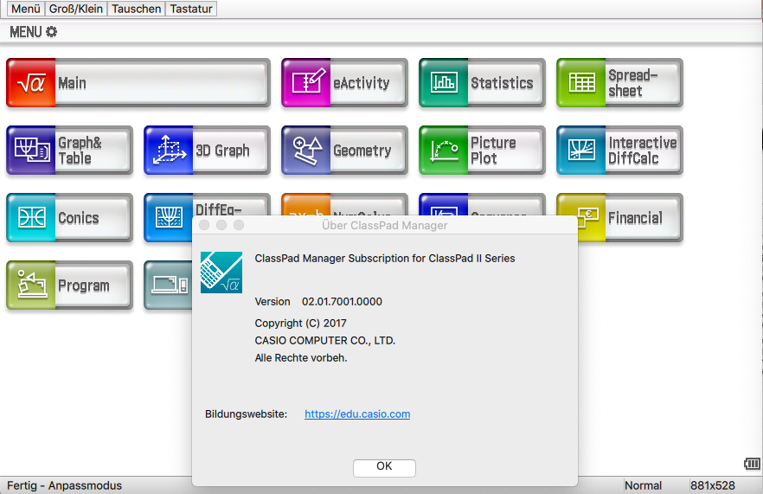
COMBINING BRUTE FORCE AND IT TO SOLVE A CLASSICAL SHOPPING PROBLEM
Current software: Status July 2023

Slide 16
COMBINING BRUTE FORCE AND IT TO SOLVE A CLASSICAL SHOPPING PROBLEM
Solution to the first word problem:
Analysis of the text and finding a suitable mathematical model:
The names of the men(M): Hendrick, Claas, and Cornelius; the names of the women(W): Geertruii, Catriin and Anna
Each person bought as many hogs as they spent shillings on each hog:
E.g. M=5 hogs for M=5 shillings each gives M²=25 [s.]
Likewise, each husband paid altogether 3 guineas more than his wife: 3 guineas = 3 * 21 shillings = 63 [s.]
Find a mathematical model!

Slide 17
COMBINING BRUTE FORCE AND IT TO SOLVE A CLASSICAL SHOPPING PROBLEM
Mathematical model: M² = W² + 63
with M, W ä {1, 2, 3, …}
You can easily see the pair of numbers: (M,W) = (8, 1)
We need three pairs of integer numbers and
consider to the equation M = (W² + 63)^{1/2}
and solve this equation using the stupid trial and error method, successively plugging in W = 1,2,3,... to find integer roots M.
However, we do the trial and error cleverly and use the ClassPad to do so. Everyone tries it for themselves now!

Slide 18
COMBINING BRUTE FORCE AND IT TO SOLVE A CLASSICAL SHOPPING PROBLEM
We need three pairs of integer numbers and consider
to the equation M = (W² + 63)^{1/2}
However, we do the trial and error cleverly and use the ClassPad to do so:
The goal is to generate a sequence of numbers "code" with W=1,2,3,...,35, which consists of zeros (0) if the root is not an integer and shows a one (1) only if the root is an integer.
code := seq( … ,W,1,35) = {1,0,0,0, …, 0,0,0}, i.e.
with a small number e := 10⁻²⁰ (possibly to correct the sign)
code := seq( f_{e}(W) , W, 1, 35) = {1,0,0,0, …, 0,0,0},

Slide 19
COMBINING BRUTE FORCE AND IT TO SOLVE A CLASSICAL SHOPPING PROBLEM
We do the trial and error cleverly and use the ClassPad to do so.
code := seq( f_{e}(W) , W, 1, 35) = {1,0,0,0, …, 0,0,0},
with a small number e := 10⁻²⁰ (possibly to correct the sign)
Here f(W) = f_{e}(W) is the following function:
Define f(W) = (1-signum( frac((W²+63)^{1/2}) - e) ) / 2
frac((W²+63)^{1/2}) returns only the decimal places,
e.g. (3²+63)^{1/2} = 8.485281374, frac((3²+63)^{1/2}) = 0.485281374 > 0
(1²+63)^{1/2} = 8.0000000, frac((1²+63)^{1/2}) = 0.0000000 = 0
frac((W²+63)^{1/2}) – e > 0, if (W²+63)^{1/2} not integer
frac((W²+63)^{1/2}) – e < 0, if (W²+63)^{1/2} integer

Slide 20
COMBINING BRUTE FORCE AND IT TO SOLVE A CLASSICAL SHOPPING PROBLEM
code := seq( f(W) , W, 1, 35) = {1,0,0,0, …, 0,0,0},
with a small number e := 10⁻²⁰ (possibly to correct the sign)
Here f(W) = f_{e}(W) is the following function:
Define f(W) = (1-signum( frac((W²+63)^{1/2}) - e) ) / 2
frac((W²+63)^{1/2}) – e > 0, if (W²+63)^{1/2} not integer
frac((W²+63)^{1/2}) – e < 0, if (W²+63)^{1/2} integer
The sign function signum(…) returns the sign as a number code +1 or -1, (signum(0) is not defined), e.g.
signum(0.485281374 - 10⁻²⁰) = +1
signum(0.000000000 - 10⁻²⁰) = -1
Finally, f(W) gives the desired code.

Slide 21
COMBINING BRUTE FORCE AND IT TO SOLVE A CLASSICAL SHOPPING PROBLEM
code := seq( f(W) , W, 1, 35) = {1,0,0,0, …, 0,0,0},
with a small number e := 10⁻²⁰ (possibly to correct the sign)
Here f(W) = f_{e}(W) is the following function:
Define f(W) = (1-signum( frac((W²+63)^{1/2}) - e) ) / 2
The sign function signum(…) returns the sign as a number code +1 or -1, (signum(0) is not defined), e.g.
Remark: another definition of f(W) by the help of the heaviside-function is (without e)
Define f(W) = 2 – 2 * heaviside( frac((W²+63)^{1/2}) )
heaviside(x)=H(x)=0, if x<0, H(x)=1/2, if x=0, H(x)=1, if x>0
Finally, f_{e}(W) or f(W) gives the desired code.

Slide 22
COMBINING BRUTE FORCE AND IT TO SOLVE A CLASSICAL SHOPPING PROBLEM
Entries in the pocket calculator, e.g. ClassPad II:
e := 10⁻²⁰
Define f(W) = (1-signum( frac((W²+63)^{1/2}) - e) ) / 2
Finally f(W) gives the desired code:
code := seq( f(W) , W, 1, 35) =
{1,0,0,0,0,0,0,0,1,0,0,0,0,0,0,0,0,0,0,0,0,0,0,0,0,0,0,0,0,0,1,0,0,0,0}
It can be seen that there are three integer solutions.
W := seq( W, W, 1, 35) * code =
{1,0,0,0,0,0,0,0,9,0,0,0,0,0,0,0,0,0,0,0,0,0,0,0,0,0,0,0,0,0,31,0,0,0,0}
M := (W²+63) ^{½} * code =
{8,0,0,0,0,0,0,0,12,0,0,0,0,0,0,0,0,0,0,0,0,0,0,0,0,0,0,0,0,0,32,0,0,0,0}

Slide 23
COMBINING BRUTE FORCE AND IT TO SOLVE A CLASSICAL SHOPPING PROBLEM
It can be seen that there are three integer solutions.
W := seq( W, W, 1, 35) * code =
{1,0,0,0,0,0,0,0,9,0,0,0,0,0,0,0,0,0,0,0,0,0,0,0,0,0,0,0,0,0,31,0,0,0,0}
M := (W²+63) ^{½} * code =
{8,0,0,0,0,0,0,0,12,0,0,0,0,0,0,0,0,0,0,0,0,0,0,0,0,0,0,0,0,0,32,0,0,0,0}
So we found the three pairs!
(M, W) = (8,1), (12,9), (32,31)

Slide 24
COMBINING BRUTE FORCE AND IT TO SOLVE A CLASSICAL SHOPPING PROBLEM
So we found the three pairs!
(M, W) = (8,1), (12,9), (32,31)
The men's names were Hendrick, Claas, and Cornelius; those of the women, Geertruii, Catriin and Anna.
Hendrick bought 23 more hogs than Catriin, and Claas bought 11 more than Geertruii:
(M, W) = (8, 1), (12=11+1, 9), (32=23+9, 31)
Now the solution can be found quickly!

Slide 25
COMBINING BRUTE FORCE AND IT TO SOLVE A CLASSICAL SHOPPING PROBLEM
So we found the three pairs (M, W) = (8, 1), (12, 9), (32, 31)
The men's names were Hendrick, Claas, and Cornelius; those of the women, Geertruii, Catriin and Anna.
Hendrick bought 23 more hogs than Catriin, and Claas bought 11 more than Geertruii:
(M, W) = (8, 1), (12=11+1, 9), (32=23+9, 31)
Claas = 12, Geertruii = 1 and Hendrick = 32, Catriin = 9, thus
(32, 31) = (Hendrick=32, W=31), (12, 9) = (Claas=12, Catriin=9)
and (M=8, W=1) = (M=8, Geertruii=1),
Thus it holds Cornelius = 8 and Anna = 31. Task solved!

Slide 26
COMBINING BRUTE FORCE AND IT TO SOLVE A CLASSICAL SHOPPING PROBLEM
Direct solution of the Diophantine equation
M² = W² + 63, i.e. M² - W² = 63 or
(M + W) * (M - W) = 1 * 3 * 3 * 7
(3. binomial formula, prime factorization)
The following three systems of equations result:
M – W = 1 and M + W = 3 * 3 * 7 = 63
M – W = 3 and M + W = 1 * 3 * 7 = 21
M – W = 7 and M + W = 1 * 3 * 3 = 9
Which can easily be solved quickly by hand (in your head):
(M,W) = (32,31), (M,W) = (12,9), (M,W) = (8,1)

Slide 27
COMBINING BRUTE FORCE AND IT TO SOLVE A CLASSICAL SHOPPING PROBLEM
So we found the three pairs (M, W) = (8, 1), (12, 9), (32, 31)
The men's names were Hendrick, Claas, and Cornelius; those of the women, Geertruii, Catriin and Anna.
Hendrick bought 23 more hogs than Catriin, and Claas bought 11 more than Geertruii:
(M, W) = (8, 1), (12=11+1, 9), (32=23+9, 31)
Claas = 12, Geertruii = 1 and Hendrick = 32, Catriin = 9, thus
(32, 31) = (Hendrick=32, W=31), (12, 9) = (Claas=12, Catriin=9)
and (M=8, W=1) = (M=8, Geertruii=1),
Thus it holds Cornelius = 8 and Anna = 31. Task solved!

Slide 28
COMBINING BRUTE FORCE AND IT TO SOLVE A CLASSICAL SHOPPING PROBLEM
Another direct solution:
Write M² = W² + 63 with M=W+K, i.e.
M² = (W+K)² = W² + 2 * W * K + = W² + 63
Thus K² + 2 * W * K - 63 = 0
and W = -K/2 + 63/(2K) = -K/2 + 1*3*3*7/(2K)
Here we check with the ClassPad II:
seq(-K/2 + 63/(2K) ,K,1,9,2) = {31, 9, 3.8, 1, -1}
and we have only tree integer solutions W = {31, 9, 1}
and M = W+K = {31+1, 9+3, 1+7} = {32, 12, 8}
Finally (M,W) = (32,31), (M,W) = (12,9), (M,W) = (8,1)

Slide 29
COMBINING BRUTE FORCE AND IT TO SOLVE A CLASSICAL SHOPPING PROBLEM
The solution of the second word problem:
“Five ladies, accompanied by their daughters, bought cloth at the same shop.
Each of the ten paid as many farthing per foot (of cloth) as she bought feet (of cloth), and each mother spent 8 s. 5¼d. more than her daughter.
Mrs Robinson spent 6 s. more than Mrs Evans, who spent about a quarter as much as Mrs Jones.
Mrs. Smith spent the most.
Mrs. Brown bought 21 yards more than Bessie - one of the girls.
Annie bought 16 yards more than Mary and spent £3, 0 s. and 8 d. more than Emily.
The Christian Name of the other was Ada. Now, what was her surname?”

Slide 30
COMBINING BRUTE FORCE AND IT TO SOLVE A CLASSICAL SHOPPING PROBLEM
The solution of the second word problem:
Analysis of the text and finding a suitable mathematical model: The names of the mothers (M):
The names of the mothers (M):
Mrs.Robinson; Mrs.Evans; Mrs.Jones; Mrs.Smith; Mrs.Brown
the names of the daughters(D): Bessie; Annie; Mary; Emily, Ada
each mother spent 8 shillings and 5¼ pennies more than her daughter: how much farthing is the difference?
The smallest monetary unit (farthing) is used to calculate with whole numbers:
8s. = 8 shilling = 8*12d. = 96d., d. = penny, 1 farthing = ¼ d.,

Slide 31
COMBINING BRUTE FORCE AND IT TO SOLVE A CLASSICAL SHOPPING PROBLEM
The solution of the second word problem:
Analysis of the text and finding a suitable mathematical model: The names of the mothers (M):
The names of the mothers (M):
Mrs.Robinson; Mrs.Evans; Mrs.Jones; Mrs.Smith; Mrs.Brown
the names of the daughters(D): Bessie; Annie; Mary; Emily, Ada
each mother spent 8 shillings and 5¼ pennies more than her daughter: 8s.+5¼ d. = (96+5¼)d. = 4* (96+5¼) = 405f.
The smallest monetary unit (farthing) is used to calculate with whole numbers:
8s. = 8 shilling = 8*12d. = 96d., d. = penny, 1 farthing = ¼ d.,

Slide 32
COMBINING BRUTE FORCE AND IT TO SOLVE A CLASSICAL SHOPPING PROBLEM
The solution of the second word problem:
Analysis of the text and finding a suitable mathematical model: The names of the mothers (M):
The names of the mothers (M):
Mrs.Robinson; Mrs.Evans; Mrs.Jones; Mrs.Smith; Mrs.Brown
the names of the daughters(D): Bessie; Annie; Mary; Emily, Ada
each mother spent 8 shillings and 5¼ pennies (= 405 farthing) more than her daughter:
e.g. T=5 feet of cloth for each T=5 farthing gives T²=25 [f.]:
Likewise, every mother paid 405 farthing more than her daughter: M² = 25 + 405 = 430, M= 430^{1/2} is not possible!
Find a mathematical model!

Slide 33
COMBINING BRUTE FORCE AND IT TO SOLVE A CLASSICAL SHOPPING PROBLEM
Mathematical model: M² = D² + 405
with M, D ä {1, 2, 3, …}
It is difficult to recognize a matching pair of numbers.
We need three pairs of integer numbers and
consider to the equation M = (D² + 405)^{1/2}
and solve this equation using the stupid trial and error method, successively plugging in D = 1,2,3,... to find integer roots M.
However, we do the trial and error cleverly and use the ClassPad to do so. Everyone tries it for themselves now!

Slide 34
COMBINING BRUTE FORCE AND IT TO SOLVE A CLASSICAL SHOPPING PROBLEM
We need five pairs of integer numbers and consider
to the equation M = (D² + 405)^{1/2}
However, we do the trial and error cleverly and use the ClassPad to do so:
The goal is to generate a sequence of numbers "code" with D=1,2,3,...,100, which consists of zeros (0) if the root is not an integer and shows a one (1) only if the root is an integer.
code := seq( … ,D,1,100) = {0,0, …, 0,1,0, …, 0,0,0}, i.e.
with a small number e := 10⁻²⁰ (possibly to correct the sign)
code := seq( f_{e}(D) , W, 1, 100) = {0,0, …, 0,1,0, …, 0,0,0},

Slide 35
COMBINING BRUTE FORCE AND IT TO SOLVE A CLASSICAL SHOPPING PROBLEM
We do the trial and error cleverly and use the ClassPad to do so.
code := seq( f_{e}(D) , D, 1, 100) = {1,0,0,0, …, 0,0,0},
with a small number e := 10⁻²⁰ (possibly to correct the sign)
Here f(D) = f_{e}(D) is the following function:
Define f(D) = (1-signum( frac((D²+405)^{1/2}) - e) ) / 2
frac((D²+405)^{1/2}) returns only the decimal places,
e.g. (3²+405)^{1/2} = 8.48528137, frac((3²+405)^{1/2}) = 0.48528137 > 0
(1²+405)^{1/2} = 8.0000000, frac((1²+405)^{1/2}) = 0.0000000 = 0
frac((D²+405)^{1/2}) – e > 0, if (D²+405)^{1/2} not integer
frac((D²+405)^{1/2}) – e < 0, if (D²+405)^{1/2} integer

Slide 36
COMBINING BRUTE FORCE AND IT TO SOLVE A CLASSICAL SHOPPING PROBLEM
We do the trial and error cleverly and use the ClassPad to do so:
code := seq( f(D) , D, 1, 100) = {0,0, …, 0,1,0, …, 0,0,0},
We try to simplify the trial and error by first considering whether only even or odd numbers are possible for M,D:
We have the following model M² = 405 + D², where M, D are positive integers. If D is odd then M is even or if D is even then M is odd.
However D = 2m+1 und M = 2n is not possible:
(2n)² = 405 + (2m+1)² results in 4*n² = 4*m²+4*m+406 or
4*(n²-m²-m)=406=2*203 or 2*(n²-m²-m)=203 Contradiction!

Slide 37
COMBINING BRUTE FORCE AND IT TO SOLVE A CLASSICAL SHOPPING PROBLEM
However, we do the trial and error cleverly and use the ClassPad: instead of increment 1
code := seq( f(D) , d, 1, 100) = {0,0, …, 0,1,0, …, 0,0,0},
It is valid D = 2m and M = 2n+1: now increment 2
With a small number e := 10⁻²⁰ (possibly for sign correction)
code1 := seq( f(D) , d, 2, 100, 2) =
{0,0,1,0,0,0,0,0,1,0,0,0,0,0,0,0,0,0,1,0,0,0,0,0,0,0,0,0,0,0,0,0,1,0,0,0,0,0,0,0,0,0,0,0,0,0,0,0,0,0} and
code2 := seq( f(D) , d, 102, 210, 2) =
{0,0,0,0,0,0,0,0,0,0,0,0,0,0,0,0,0,0,0,0,0,0,0,0,0,0,0,0,0,0,0,0,0,0,0,0,0,0,0,0,0,0,0,0,0,0,0,0,0,0,1,0,0,0,0}
This results in five solutions!

Slide 38
COMBINING BRUTE FORCE AND IT TO SOLVE A CLASSICAL SHOPPING PROBLEM
Here f(D) = f_{e}(D) is the following function:
Define f(D) = (1-signum( frac((D²+405)^{1/2}) - e) ) / 2
frac((D²+405)^{1/2}) – e > 0, if (D²+405)^{1/2} not integer
frac((D²+405)^{1/2}) – e < 0, if (D²+405)^{1/2} integer
The sign function signum(...) returns the sign as a number code +1 or -1, (signum(0) is not defined), e.g
signum(0.485281374 - 10⁻²⁰) = +1
signum(0.000000000 - 10⁻²⁰) = -1
Finally f(D) gives the desired code.

Slide 39
COMBINING BRUTE FORCE AND IT TO SOLVE A CLASSICAL SHOPPING PROBLEM
It can be seen that there are five integer solutions.
D := seq( D, D, 2, 100, 2) * code1 =
{0,0,6,0,0,0,0,0,18,0,0,0,0,0,0,0,0,0,38,0,0,0,0,0,0,0,0,0,0,0,
0,0,66,0,0,0,0,0,0,0,0,0,0,0,0,0,0,0,0,0} and
M := (D²+405) ^{½} * code1 =
{0,0,21,0,0,0,0,0,27,0,0,0,0,0,0,0,0,0,43,0,0,0,0,0,0,0,0,0,0,0,
0,0,69,0,0,0,0,0,0,0,0,0,0,0,0,0,0,0,0,0}
So we already have the four pairs
(M, D) = (21,6), (27,18), (43,38), (69,66)
found!

Slide 40
COMBINING BRUTE FORCE AND IT TO SOLVE A CLASSICAL SHOPPING PROBLEM
Furthermore
D := seq( D, D, 102, 210, 2) * code2 =
{0,0,0,0,0,0,0,0,0,0,0,0,0,0,0,0,0,0,0,0,0,0,0,0,0,0,0,0,0,0,0,0,
0,0,0,0,0,0,0,0,0,0,0,0,0,0,0,0,0,0,203,0,0,0,0}
and
M := (D²+405) ^{½} * code2 =
{0,0,0,0,0,0,0,0,0,0,0,0,0,0,0,0,0,0,0,0,0,0,0,0,0,0,0,0,0,0,0,0,
0,0,0,0,0,0,0,0,0,0,0,0,0,0,0,0,0,0,202,0,0,0,0}
We have found the fifth pair:
(M, D) = (203,202)

Slide 41
COMBINING BRUTE FORCE AND IT TO SOLVE A CLASSICAL SHOPPING PROBLEM
We have found the five pairs:
(M, D) = (21,6), (27,18), (43,38), (69,66), (203,202)
The names of the mothers (M):
Mrs.Robinson; Mrs.Evans; Mrs.Jones; Mrs.Smith; Mrs.Brown
the names of the daughters(D): Bessie; Annie; Mary; Emily, Ada
Mrs. Robinson spent 6 shillings more than Mrs. Evans, who spent about a quarter as much as Mrs. Jones.
It holds: 6s. = 6*12d. = 6*12*4f. = 288f.,
4*441f. = 1764f. near 1849
M² = {21,27,43,69,203}² = {441,729=441+288,1849,4761,41209}
Now the solution can be found quickly!

Slide 42
COMBINING BRUTE FORCE AND IT TO SOLVE A CLASSICAL SHOPPING PROBLEM
The five pairs are
(M, D) = (21,6), (27,18), (43,38), (69,66=18(Mary)+48), (203,202)
= (Mrs.Evans,6),(Mrs.Robinson,18),(Mrs.Jones,38),(69,66),(203,202)
Mrs. Smith spent the most: (Mrs.Smith = 203, 202)
Thus (Mrs.Brown = 69 = 63 + 6(Bessie), 66).
Now the daughters can be assigned:
Mrs. Brown(=69 feet) bought 21 yards(=63 feet) more than Bessie - one of the girls. Thus Bessie = 6 feet and the first pair is
(21,6) = (Mrs.Evans = 21, Bessie Evans = 6)
Annie bought 16 yards (=48 feet) more than Mary
and spent £3, 0 shillings and 8 pence (=2912f.) more than Emily.
3£+0s.+8d. = 3*20*12d.+8d. = 728d. = 4*728f. = 2912f.

Slide 43
COMBINING BRUTE FORCE AND IT TO SOLVE A CLASSICAL SHOPPING PROBLEM
Annie bought 16 yards (=48 feet) more than Mary
and spent £3, 0 shillings and 8 pence (=2912f.) more than Emily.
3£+0s.+8d. = 3*20*12d.+8d. = 728d. = 4*728f. = 2912f.
D² = {6, 18(Mary), 38, 66=18+48(Annie), 202}² =
{36, 324, 1444(Emily), 4356=1444+2912(Annie), 40804},
because 2912 = 4356-1444, i.e.
(M=69, D=66) = (Mrs. Brown, Annie Brown),
(M=27, D=18) = (Mrs. Robinson, Mary Robinson),
(M=43, D=38) = (Mrs. Jones, Emily Jones).
Finally stays (M=203, D=202) = (Mrs. Smith, Ada Smith).
Task solved!

Slide 44
COMBINING BRUTE FORCE AND IT TO SOLVE A CLASSICAL SHOPPING PROBLEM
Direct solution of the Diophantine equation
M² = D² + 405, i.e. M² - D² = 405 or
(M + D) * (M - D) = 1 * 3⁴ * 5
(3. binomial formula, prime factorization)
The following three systems of equations result:
M – D = 1 and M + D = 3⁴ * 5 = 405
M – D = 3 and M + D = 1 * 3³ * 5 = 135
M – D = 5 and M + D = 1 * 3⁴ = 81
M – D = 3² = 9 and M + D = 1 * 3² * 5 = 45
M – D = 3*5 = 15 and M + D = 1 * 3³ = 27

Slide 45
COMBINING BRUTE FORCE AND IT TO SOLVE A CLASSICAL SHOPPING PROBLEM
which can easily be solved quickly by hand (in your head):
(M, D) = (21, 6), (27, 18), (43, 38), (69, 66), (203, 202)
Thus the pairs (M,D), see above,
(M=21,D=6) = (Mrs.Evans, Bessie Evans)
(M=27, D=18) = (Mrs. Robinson, Mary Robinson),
(M=43, D=38) = (Mrs. Jones, Emily Jones).
(M=69, D=66) = (Mrs. Brown, Annie Brown),
(M=203, D=202) = (Mrs. Smith, Ada Smith).
Task solved!

Slide 46
COMBINING BRUTE FORCE AND IT TO SOLVE A CLASSICAL SHOPPING PROBLEM
Another direct solution:
Write M² = D² + 405 with M=D+K, i.e.
M² = (D+K)² = D² + 2 * D * K + K² = D² + 405
Thus K² + 2 * D * K - 405 = 0
and D = -K/2 + 405/(2K) = - K / 2 + 1 * 3⁴ * 5 / (2K)
Here we check with the ClassPad II:
fRound(seq(-K/2 + 405/(2K) ,K,1,21,2), 2) =
{202, 66, 38, 25.43, 18, 12.91, 9.08, 6, 3.41, 1.16, -0.86}
we have five integer solutions D = {202, 66, 38, 18, 6} and
M = D+K = {202+1, 66+3, 38+5, 18+9, 6+15} = {203, 69, 43, 27, 21}
Finally (M, D) = (203,202), (69,66), (43,38), (27,18), (21,6)

Slide 47
COMBINING BRUTE FORCE AND IT TO SOLVE A CLASSICAL SHOPPING PROBLEM
References:
Dudeney, H.E. (1917, 1958). Amusements in Mathematics. Nelson London, pp. 26-27
http://djm.cc/library/Amusements_in_Mathematics_Dudeney_edited02.pdf
Hemme, H.(2019). Die Holländer kaufen Schweine, Spektrum der Wissenschaft,
https://www.spektrum.de/raetsel/die-hollaender-kaufen-schweine/1579982
Hvorecký, J., Korenova, L., Barot, T. (2022). Combining Brute Force and IT to Solve Difficult Problems. Electronic Proceedings of the 27th Asian Technology Conference in Mathematics (ATCM) 2022, Dec. 9-12, Prague, https://atcm.mathandtech.org/EP2022/regular/21959.pdf
May, J. (1739). Three Dutchmen, The Ladies’ Diary: Puzzle
https://www.cantorsparadise.com/three-dutchmen-f9f08ac19d73
Workman, W.P. (1906, 1918). The Tutorial Arithmetic: with Answers. Univ. Tutorial Press London, p. 482
https://cs.smu.ca/~dawson/workman/workman3.gif

Slide 48
COMBINING BRUTE FORCE AND IT TO SOLVE A CLASSICAL SHOPPING PROBLEM
Thank you very much for your attention!

