Slide 1
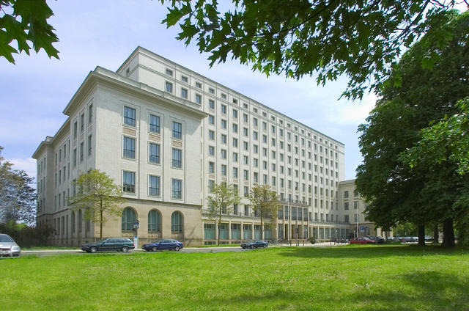
Understanding of Sets and Venn-Diagrams
Dresden University of Applied Sciences

Slide 2
Understanding of Sets and Venn-Diagrams
IMPROVEMENT OF STUDENTS’ UNDERSTANDING
OF ALGEBRA OF SETS AND VENN-DIAGRAMS
Preface:
The basics of set theory consists in sets, elements, lists, set-builder notation, subsets, equal sets, the empty set, union, intersection, difference, symmetric difference and Cartesian product and power sets.
Sets are one of the most fundamental concepts in mathematics but we can’t calculate with set operations and set relations on any calculators, e.g. on the ClassPad. On the other hand we can write in the text mode with special symbols of the set theory in the ClassPad, e.g. ∈, ∉, ∪, ∩ , \ , ⊂ , ⊆ , ≠ , ….

Slide 3
Understanding of Sets and Venn-Diagrams
1. Introduction:
Some students of informatics tried to introduce the set theory in the operating system of the calculator.
They followed several ways of solution:
Create a so called AddIn for ClassPad330 to calculate with sets of real numbers or finite sets of words and
Create a Basic-program for ClassPad400 to calculate with finite sets of numbers or words.
For the visualizing we get Venn-diagrams for a basic set Ω and up to four subsets A, B, C, D of Ω.
An important application consists in the basics of probability theory if the sets are random events.

Slide 4
Understanding of Sets and Venn-Diagrams
Examples of Sets:
In the mathematics these days essentially everything is a set.
Some knowledge of the set theory is a necessary part of the background everyone needs for the further study of math.
We want to review here elementary-school set theory and the algebra of sets. Finally we will use the calculator to compute and draw Venn-diagrams.
A set is a collection of things (called its members or elements), e.g. the set of the prime numbers less 10: A={2,3,5,7} or the set B of all real solutions of the polynomial equation x⁴-17x³+ 101x²-247x+210=0, i.e. B=A. B and A were defined in different ways.
Let be ∅ = {x| x ≠ x} the empty set. We can form the set {∅} and {{∅}} and finally {∅,{∅},{{∅}}}, a three element set.

Slide 5
Understanding of Sets and Venn-Diagrams
Two other familiar operations on sets are the union and intersection.
For example {x,y}∪{z}={x,y,z} or {2,3,5,7}∩{1,2,3,4}={2,3}.
Any set A will have one or more subsets.
In fact if A has n elements then A has 2^{n} subsets.
We can gather all of the subsets of A into one collection called the power set of A.
For example
the power set of {0,1} is {∅,{0},{1},{0,1}} and
the power set of ∅ is {∅} and
the power set of {∅} is {∅,{∅}}.

Slide 6
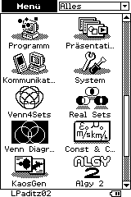
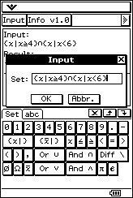
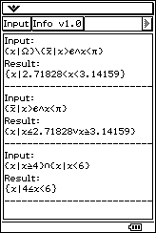
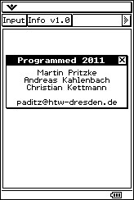
Understanding of Sets and Venn-Diagrams
2. The AddIn „REAL SETS“ for ClassPad330:
The students wrote a program in C⁺⁺ and used then the CASIO-SDK (software development kid) to compile the source program into a ClassPad AddIn.

Slide 7
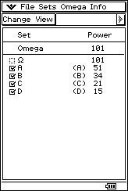
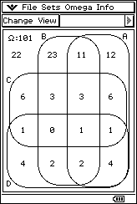
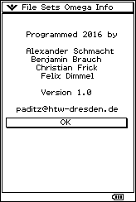
Understanding of Sets and Venn-Diagrams
3. The AddIn „VENN4SETS“ for ClassPad330:
Other students wrote a program in C⁺⁺ and used then the CASIO-SDK (software development kid) to compile the source program into a ClassPad AddIn.
Let be Ω={0,1,2,3,…,99,100},
A={0,2,4,6,…,98,100}, B={0,3,6,9,…,96,99},
C={0,5,10,15,…,95,100}, D={0,7,14,21,…,91,98}

Slide 8
Understanding of Sets and Venn-Diagrams
4. THE PROGRAM “STROVENN” FOR CP400
The program StrOVenn works with sets, which are String-variables. The Output is a Venn-diagram. Therefore the program is named StrOVenn. The syntax of the input is
StrOVenn(Ω,A,B,C,D,4,2,1) or
StrOVenn(Ω,A,B,C,dummy,3,2,1) or
StrOVenn(Ω,A,B,dummy,dummy,2,2,1).
The last parameter 1 describes the type of data: numeric or alpha-numeric sets. Later the parameter 0 in the last position should be for the single type: numeric sets. Finally the fixed parameter 2 stands for a color Venn-diagram (ClassPad400) or 1 for a black/white diagram (ClassPad330).

Slide 9
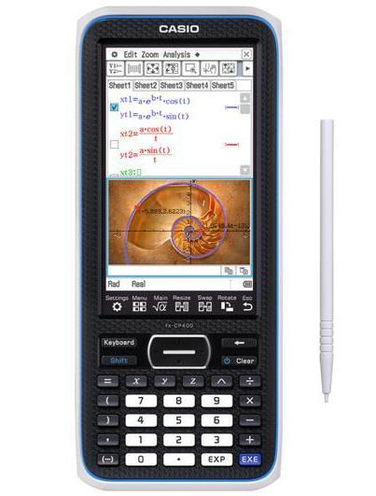
Understanding of Sets and Venn-Diagrams
The tool – ClassPad 400
Again let be
Ω=“{0,1,2,3,4,5,…,99,100}“
A=“{0,2,4,6,8,10,…,98,100}“
B=“{0,3,6,9,12,14,…,96,99}“
C=“{0,5,10,15,20,…,95,100}“
D=“{0,7,14,21,28,…,91,98}“

Slide 10
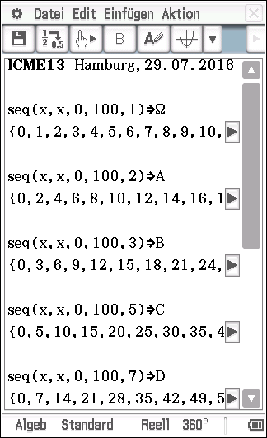
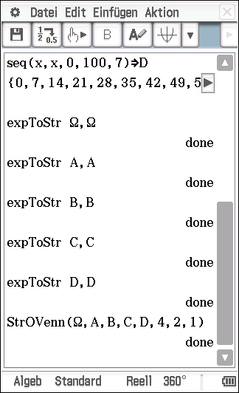
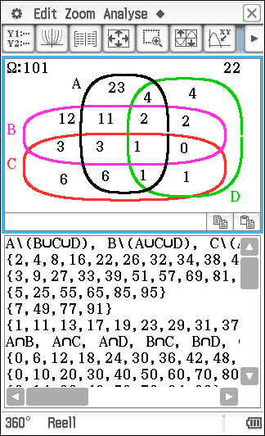
Understanding of Sets and Venn-Diagrams
With StrOVenn(Ω,A,B,C,D,4,2,1) we get the results:

Slide 11
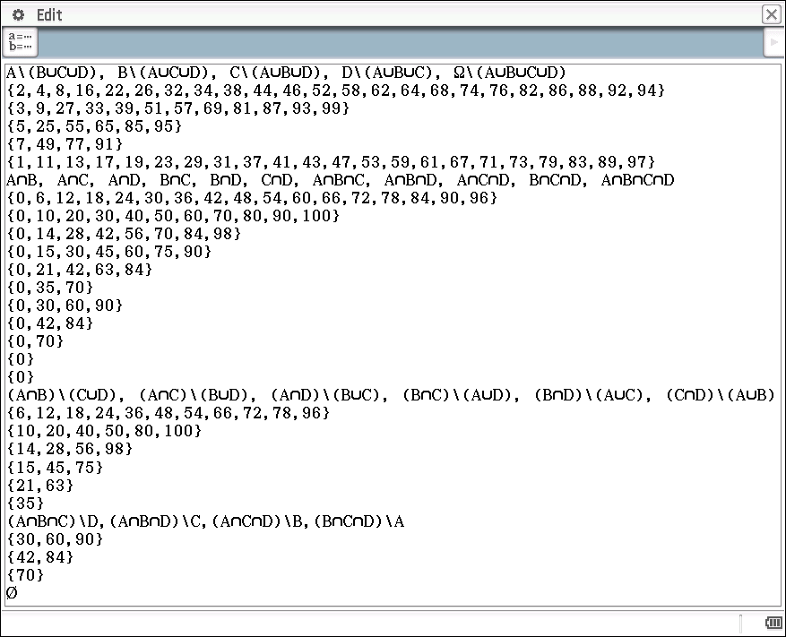
Understanding of Sets and Venn-Diagrams
With the PC-ClassPad Manager we get the full screen:

Slide 12
Understanding of Sets and Venn-Diagrams
A student discovered all prime numbers between 0 and 100 in the set
Ω\(A ∪ B ∪ C ∪ D)=
{1,11,13,17,19,23,29,31,37,41,43,47,
53,59,61,67,71,73,79,83,89,97}
where 1 is no prime number, but 2 (not in this set).
Probability theory: Let P(ω)=1/n, for all ω∈Ω and n=|Ω|=101
What is the probability P((A ∩ B)\(C∪D)) of the difference
(A ∩ B)\(C∪D) ?
What is the conditionel probability P((A ∩ B)|(C∪D)) with the condition (C∪D) ?
By the help of the Venn-diagram it is easy to get the solution.

Slide 13
Understanding of Sets and Venn-Diagrams
Wallisch, F. (2015):
mp4-video of a student:
“Testdurchlauf-vierMengen”
http://www.informatik.htw-dresden.de/
~paditz/Testdurchlauf-vierMengen.mp4

Slide 14
Understanding of Sets and Venn-Diagrams
Thank you for your attention!

